Slide 1
Unified mentor FrontEnd Development Internship :
Tic-Tac-Toe
My Portfolio
Weather App
To-Do App
Basic Calculator
Recipe Book
Music Player
Interactive Resume
Info
Graphics
Virtual Pet Simu
Thispresentationshowcaseswebdevelopmentproject:Virtual Pet Simulator.ThisprojectutilizeHTML,CSS, andJavaScript,demonstratingmycodingskillsandprojectdevelopment experience.Thisprojecthighlightmyabilitytocreateinteractiveandengaging webapplications,showcasingmypassionforwebdevelopmentandcommitment tobuildinghigh-quality, user-friendlywebsite.
A Web Development Showcase
Memory Card Game
Interactive Quiz
Countdown Timer
Blog Website
Virtual Art gallery
byMandadiRohitReddy
InternshipID:UMIP278665
M R
Chat Application
Interactive Story telling
Interactive Map
Image Slider
Expense Tracker

Slide 2

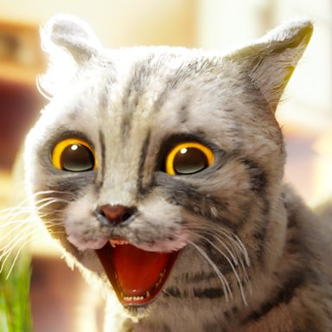

Project Virtual Pet Simulator in HTML, CSS and Java Script
Let's set our project up for success
Presenter Name

Slide 3
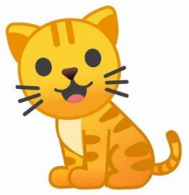
Introduction
Welcome to the Virtual Pet Simulator, a fun and interactive web-based application built using HTML, CSS, and JavaScript. This project simulates the experience of caring for a digital pet, allowing users to feed it, play with it, and monitor its health and happiness. Designed as both an educational and entertaining experience, this simulator demonstrates how front-end web technologies can be used to create dynamic and responsive user interfaces.
The primary goal of this project is to reinforce core web development concepts, including DOM manipulation, event handling, and styling with CSS, while encouraging creativity and interactivity. Whether you’re a beginner learning JavaScript or a developer looking to practice project-based learning, this virtual pet simulator is a great hands-on way to explore the potential of client-side programming.

Slide 4


🐾 Project Overview: Virtual Pet Simulator
The Virtual Pet Simulator is an interactive web-based application that allows users to adopt and take care of a virtual pet through a clean, intuitive interface. Built using HTML, CSS, and JavaScript, this project simulates the responsibilities of pet ownership in a fun and engaging way. Users can feed, play with, and monitor the mood and health of their pet, making real-time decisions to keep it happy and healthy.

Slide 5
🎯 Key Features:
01
02
Adopt a Pet: Choose your virtual companion and give it a name.
Real-Time Interaction: Feed, play, and rest your pet using interactive buttons.
03
04
Mood & Health System: The pet’s mood and health dynamically change based on user interaction and time.
Custom Animations & Styling: Smooth animations and responsive design for a delightful user experience.

Slide 6
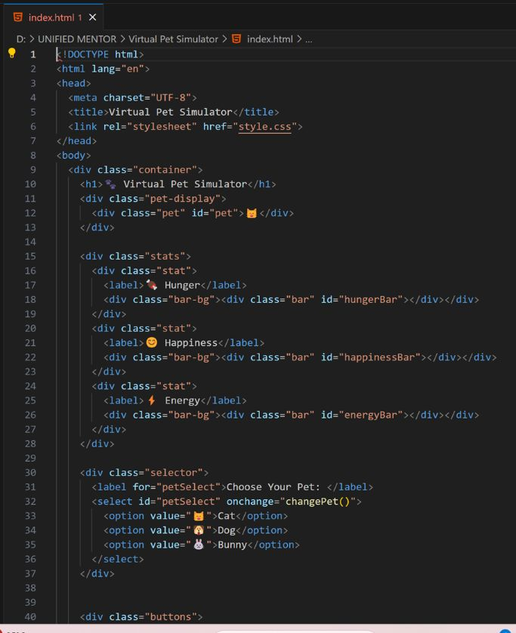
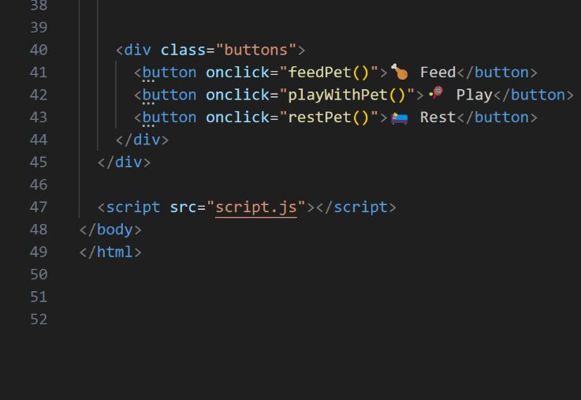
🔧 Tech Stack:
HTML
Structured the layout with semantic tags to organize elements like pet display, action buttons, and status indicators.

Slide 7
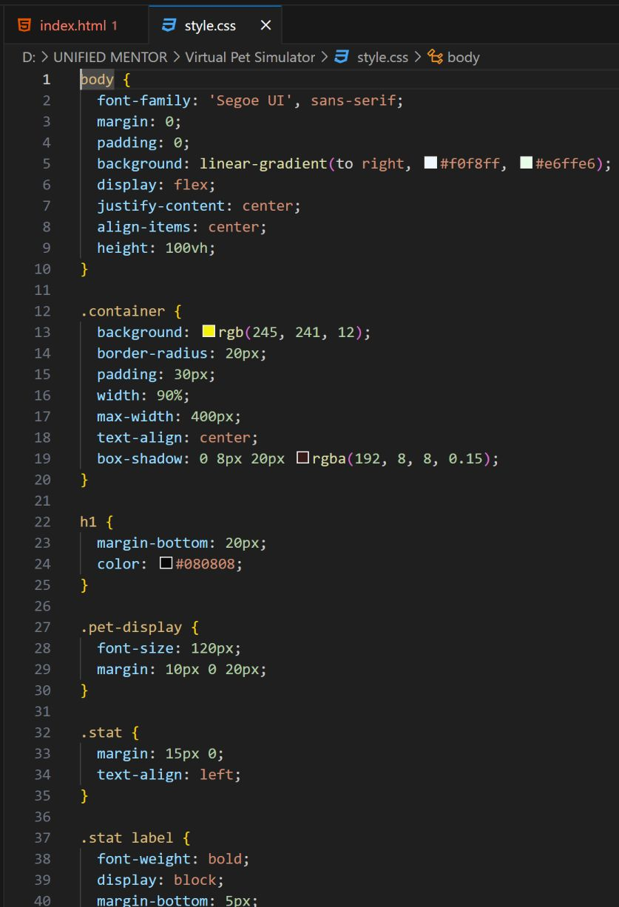
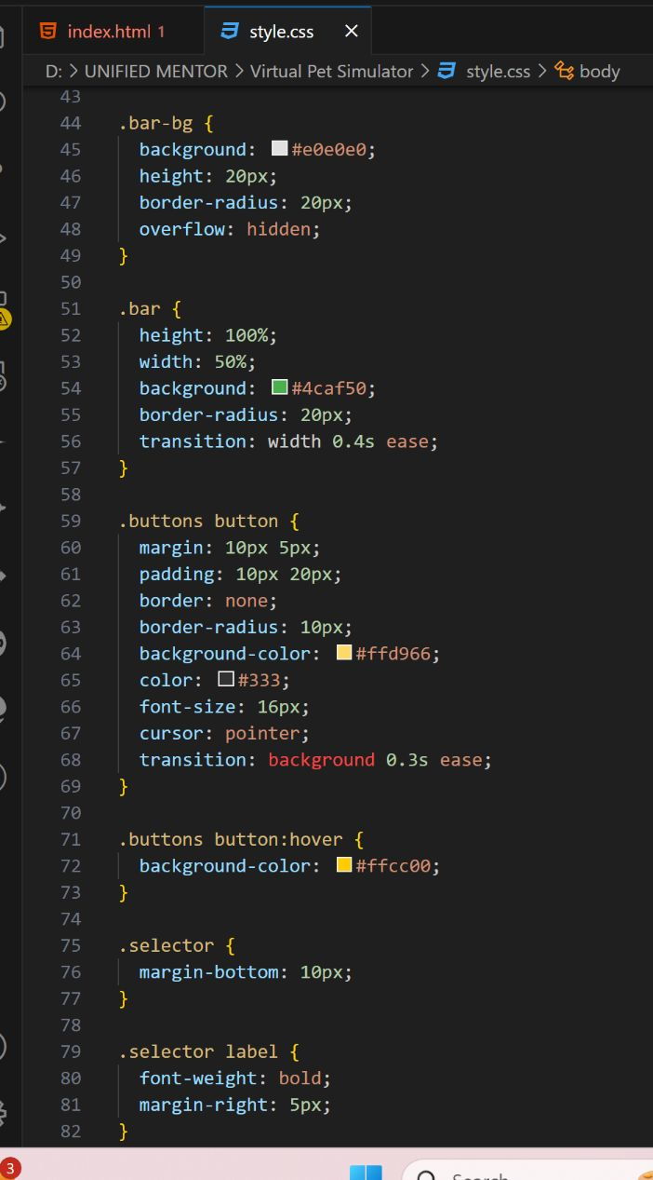
🔧 Tech Stack:
CSS
Structured the layout with semantic tags to organize elements like pet display, action buttons, and status indicators.

Slide 8
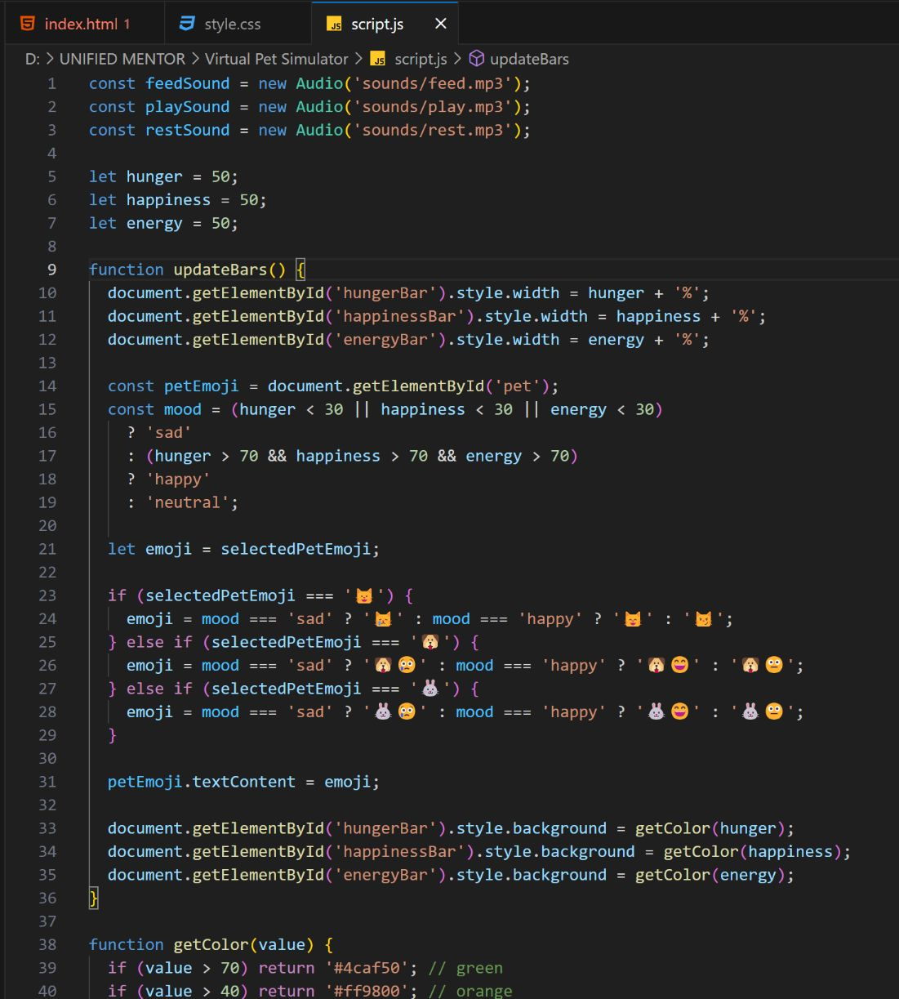
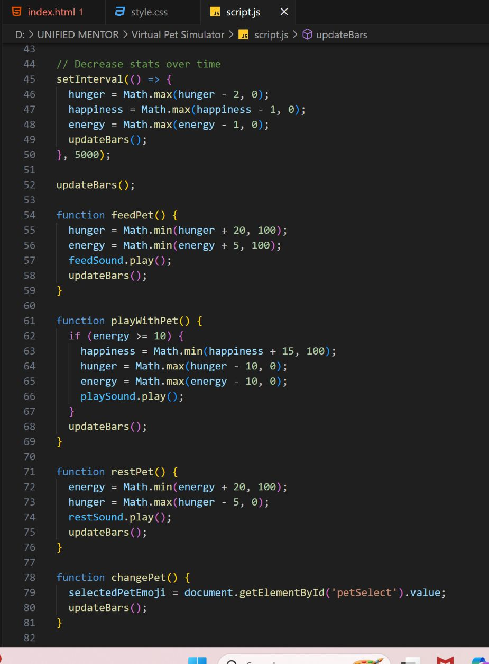
🔧 Tech Stack:
Javascript
Structured the layout with semantic tags to organize elements like pet display, action buttons, and status indicators.

Slide 9

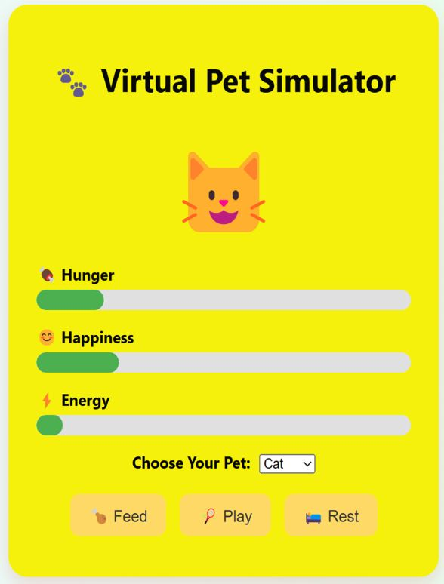
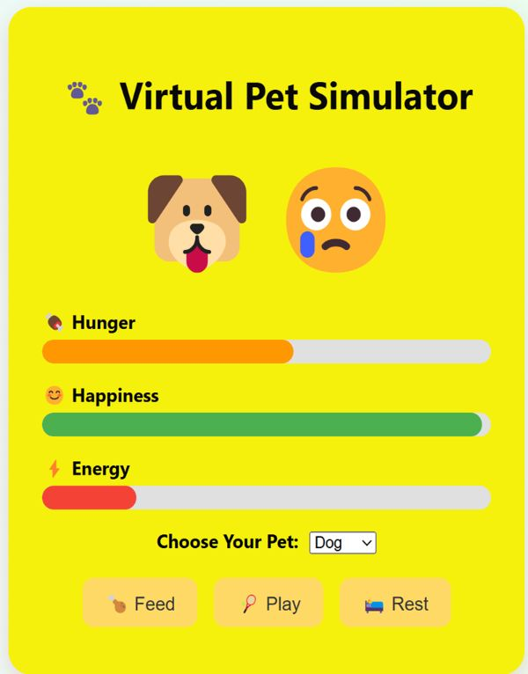

Project Output:

Slide 10
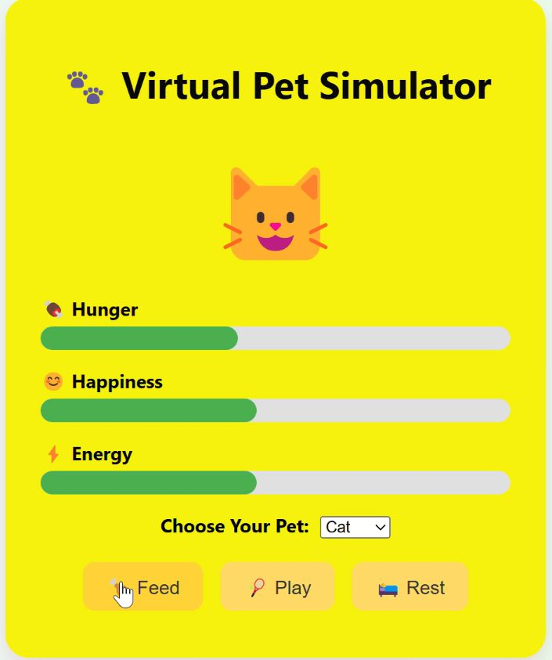
Project Output Video:

Slide 11
✅ Conclusion
The Virtual Pet Simulator demonstrates how a simple yet engaging application can be created using core web technologies—HTML, CSS, and JavaScript. It not only simulates basic pet-care activities but also encourages users to interact regularly, making the experience both fun and educational. This project helped reinforce concepts such as DOM manipulation, event-driven programming, and responsive design while offering a creative outlet for implementing real-time interactions

Slide 12
🚀 Future Enhancements
To make the Virtual Pet Simulator even more immersive and feature-rich, the following enhancements can be considered:
Multiple Pet Options: Introduce different pet types (dogs, cats, dragons, etc.) with unique behaviors and sounds.
Sound Effects & Background Music: Add playful sound effects to enhance interaction and overall experience.
Customizable Environment: Let users change the pet’s background or room style to personalize the game.
Pet Evolution: Implement a leveling system where pets grow or evolve over time based on user care.
Mini-Games: Include small games that the pet can play with the user to boost happiness or reduce boredom.
Dark Mode Support: Add theme-switching functionality for better user accessibility.
Progress Persistence: Use localStorage or backend integration to save progress across sessions.
Mobile Optimization: Improve the mobile layout and touch responsiveness for a smoother experience on phones and tablets.

Slide 13
🚀 Social Media Link:
Website Link: Virtual Pet Simulator
Github Link:

Slide 14
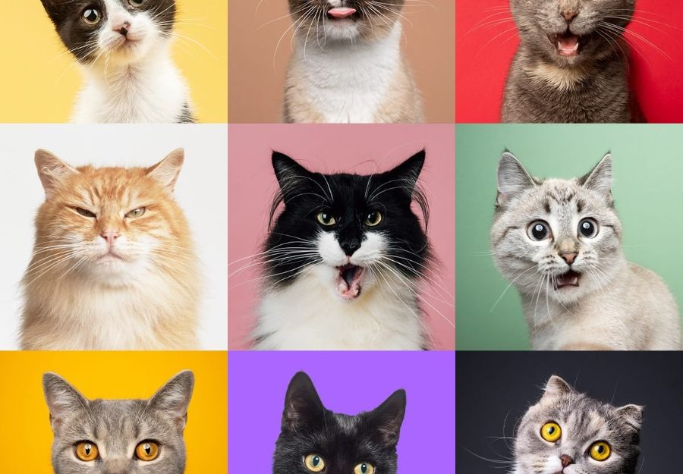
Thank You

